Slide 1
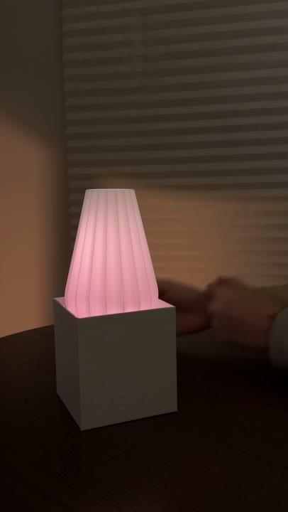
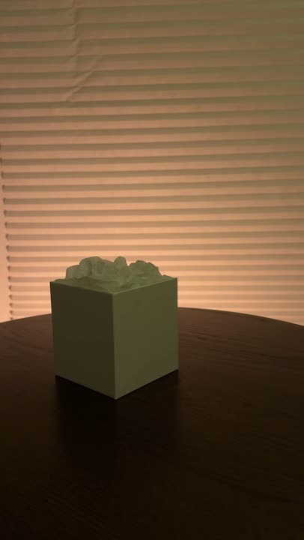
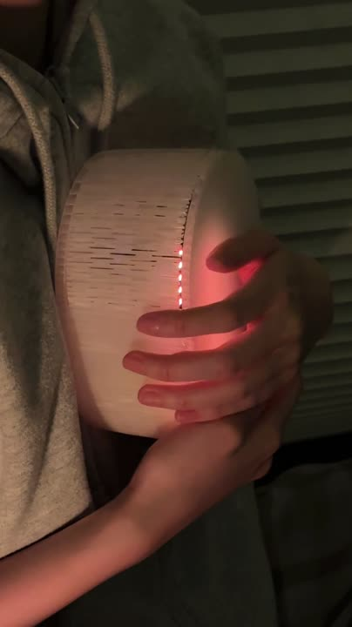
Example 3-videos
Prototype 1
Prototype 2
Prototype 3
NearLight
Arueole
Embré
Proximity sensor + LED
Sound sensor + LED
Axis accelerometer + LED
Makes “being near” feel like being with.
A small, authored moment of care
—“I lit this for you”
Regulates stress and communicates
presence through a human rhythm.

Slide 2
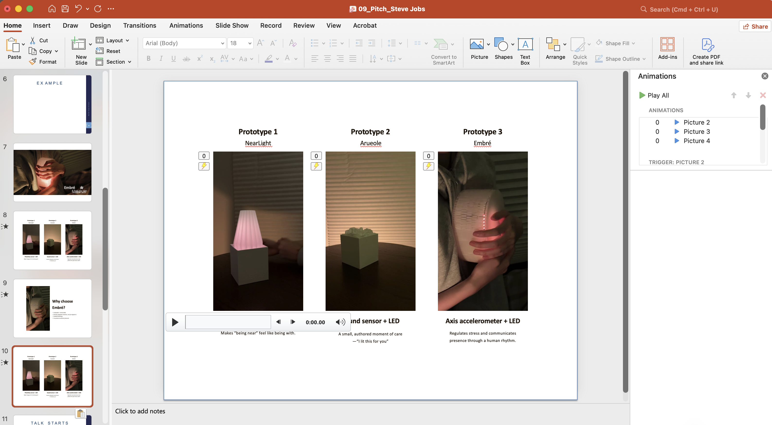
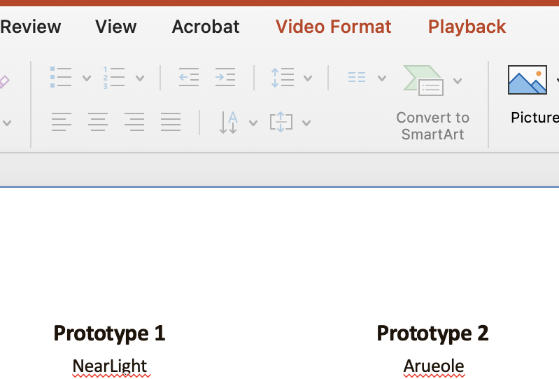
Set all 3 videos to play back and loop automatically.

